Slide 1

Quantum image compression
24aim111 – introduction to data structure and algorithms
24aim112 – Mathematics for intelligent system 2
Team members :
Akhillesh varathan cs – cb.ai.u4aim24102
Jeffrin merino j – cb.ai.u4aim24118
K Deepak Skandh – cb.ai.u4aim24119
Kavin m – cb.ai.u4aim24121

Slide 2
Introduction :
Quantum image compression algorithms leverage the principles of quantum mechanics to represent and compress images in a more efficient way than classical algorithms. These algorithms can potentially reduce the amount of data required to store or transmit images, while maintaining acceptable image quality.

Slide 3
Literature review:
S.NO | TITLE | AUTHOR | TECHNIQUES USED
1. | Quantum Image Compression: Fundamentals, Algorithms, and Advances | Sowmik Kanti Deb and W. David Pan | The authors have Quantum Image Representation using FRQI and NEQR, leveraging Quantum Gates and Circuits for efficient Lossy and Lossless Compression. It utilizes Entanglement, Superposition, Unitary Transformations, and Tensor Products for parallel image processing
2. | Quantum Computation-Based Image Representation, Processing Operations and Their Applications | Fei Yan, Abdullah M. Iliyasu, and Zhengang Jiang | The authors used FRQI for quantum image encoding, GTQI for position manipulation, CTQI for colour adjustments, and MCQI for RGB encoding. Applications include Quantum Watermarking, Quantum Video Encryption, and Parallel Image Comparison for efficient processing.
 |  |  | .

Slide 4
3. | Signal and Image Compression Using Quantum Discrete Cosine Transform | Chao-Yang Pang Ri-Gui Zhou Ben-Qiong Hu WenWen Hu | The author have used QDCT for efficient DCT computation, leveraging Grover’s Algorithm for coefficient selection, Quantum Parallelism for faster processing, and Quantum Image Representation for encoding. A Quantum Iterative Search with two oracles enhances efficiency, while QFT supports transformations.
4. | Advanced Quantum Image Representation and Compression Using a DCT- EFQRI Approach | Md Ershadul Haque, Manoranjan Paul, Anwaar Ulhaq, Tanmoy Debnath | DCT-EFRQI (DCT-based quantum compression), DWT (frequency decomposition), GQIR (logarithmic encoding), EFRQI (optimized GQIR), and Quirk (quantum circuit simulation).

Slide 5
Research gaps:
Efficient Quantum Image Representation.
Noise and Error Correction.
Scalability and Hardware.
Integration with Quantum Machine Learning.
Real-world Applications and Benchmarks.

Slide 6
Problem statement:
Real life Problems our Project Aims to Tackle:
Secured image storage and transmission.
Large scale image analysis.
Image can be retrieved from its quantum circuit including its pixel and position.

Slide 7
METHODOLOGY:
Represent DCT Coefficients using quantum
circuit
Store it in 8x8 DCT
Image
DCT and Quantization
Evaluation Matrix
Inverse DCT
Inverse quantization
Compression

Slide 8
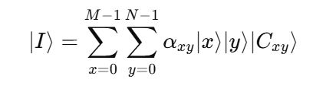
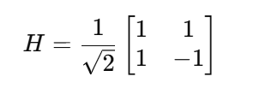
Mathematics Part Involved:
EFRQI:
Method used to represent images efficiently in quantum state.
HADAMARD GATES:
Transforms classical bits (0 or 1) into quantum bits (qubits) by creating superposition

Slide 9
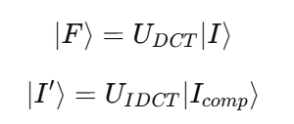
QUANTUM CIRCUITS:
The DCT transformation and Inverse DCT (IDCT) are implemented as quantum unitary matrices, which act on qubits.

Slide 10
DSA PART INVOLVED:
SPARSE MATRIX: | Stores DCT Coefficients
HASH TABLES: | Maps Significant Coefficients to their positions
PRIORITY QUEUES: | Selects the most important Coefficients
Quantum Registers: | Stores pixel positions in quantum state.
QUANTUM CIRCUITS[UNITARY MATRIX] | Performs DCT and IDCT using quantum operations
QUANTUM HASH TABLES | Stores quantum-encoded pixel intensity values

Slide 11
Applications:
Reducing time complexity in deep learning
Quantum assisted image restoration
Steganography
Satellite Image Analysis

Slide 12
THANK YOU

